Slide 1
User Information Augmentation. Vision based Information Delivery System
Team: SDDec19-14
Advisor: Aleksandar Dogandzic
Client: Radek Kornicki of Danfoss

Slide 2
Problem Statement
Operating heavy machinery can be dangerous
Heavy machinery on highways can hinder traffic
HUD to remedy this situation
Determine viability on a larger scale
SDDEC19-14

Slide 3
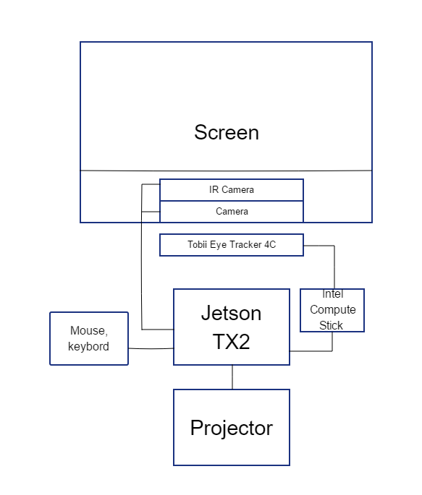
Conceptual sketch
SDDEC19-14

Slide 4
Market Survey
Tobii
Nuance
Our design uses a projector, not a tablet, to display information
SDDEC19-14

Slide 5
Functional Requirements
Identify road lanes
Identify important objects
Track user’s eyes
Project a heads up display
Track sensor health
User friendly calibration
SDDEC19-14

Slide 6
Non-Functional Requirements
Eye tracking and object detection in real time
Detection done accurately
HUD updated consistently
System protected from malicious intent
Easy to start
SDDEC19-14

Slide 7
Other Constraints
Economically Feasible
+70% Transparent film
Jetson TX2
Tobii Eye Tracker 4C
SDDEC19-14
Notes:
Sunk cost with Jetson and Tobii, Jetson nano
Vision blocking?
Looking for most cost effective method
We are using an ARM device - restricts us
Time

Slide 8
Potential Risks and Mitigation
Jetson’s speed
Technical Experience
Tensorflow
Real-time systems
Connectivity issues between hardware
SDDEC19-14
Notes:
Most people are new to the topics we will cover
Talk to outside parties that might be familiar with these technologies
Jetson won’t be fast enough
Real time system
The jetson is probably overshooting our goals but we are using it for simplicity
Connectivity
Plan out different ideas, like an intermediate uC

Slide 9
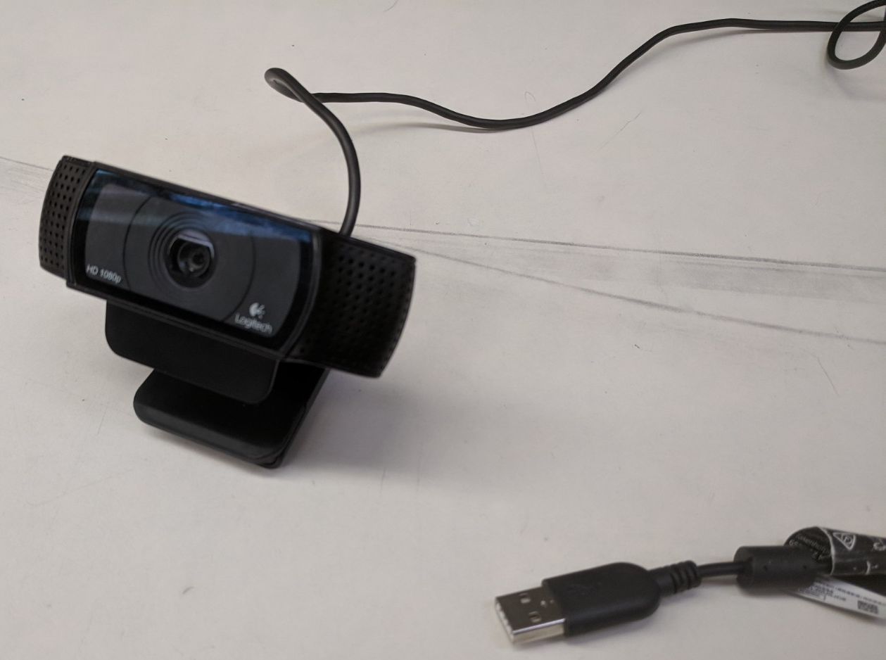
Resource/Cost Estimate
Cost: ~$1,230
Hours of effort: ~360 hours
SDDEC19-14

Slide 10
Cost of Devices
Jetson TX2: $540
Tobii Eye tracker: $150
Generic Projector: ~$80
Projection Film: ~$40
Cameras: ~$300
Intel Compute Stick: $120
Total Cost: $1,230
SDDEC19-14
Notes:
Maybe remove this?

Slide 11
Project Milestones & Schedule
Tobii Eye Tracker 4C connected to Jetson TX2
Object detection
Heads-up display (HUD) display
Component integration
SDDEC19-14
Notes:
Maybe add a fancy graphic here that shows the milestones in a more interesting light?

Slide 12
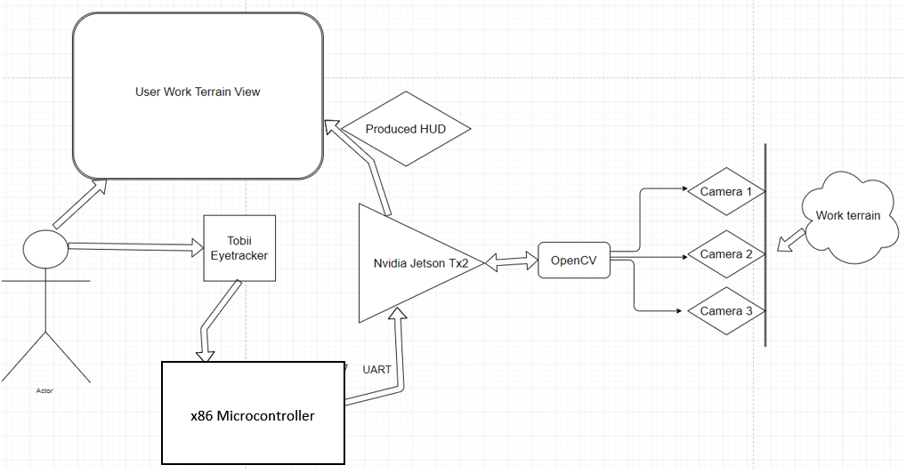
Functional decomposition
/Tensorflow
SDDEC19-14
Notes:
Mention that we were not gonna use x86 MCU
Detailed design is very direct. Used same materials given to us by client so far
Mention tensorflow may mitigate latency more than opencv
Hud will be produced using java language and projected onto a windshield
Why 3 camera’s? One RGB, one Infrared, one depth, can be same camera different lense

Slide 13
Reason for Intel Compute Stick
Directly using USB
WINE virtualization
ROS wrapper
StreamEngine/support files from Tobii
QEMU

Slide 14
Design
Such that it is stationary in a vehicle or a fixed space where the user is stationary as well
Tobii eye tracker used so we don’t have to worry about head movement
Tensorflow used to reduce latency in object detection to provide real time system
X86 MCU used to communicate with Tobii in the stead of the Jetson
MCU UART used since data from Tobii to Jetson is not that large
Simple project projects onto film as opposed to using electronic
Transparent screen
SDDEC19-14
Notes:
Mention that we were not gonna use x86 MCU
Detailed design is very direct. Used same materials given to us by client so far
Mention tensorflow may mitigate latency more than opencv
Hud will be produced using java language and projected onto a windshield
Mention software running on nvidia jetson

Slide 15
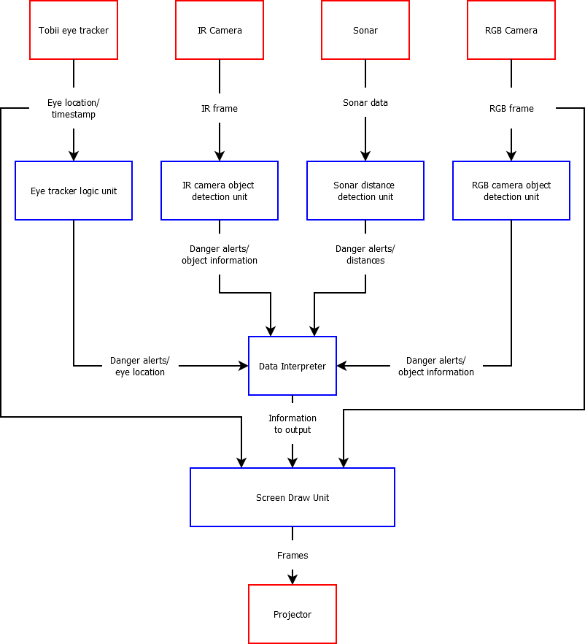
SDDEC19-14

Slide 16
SDDEC19-14

Slide 17
Hardware/Software/Technology Used
Nvidia Jetson Tx2/ Jetson nano
Tobii Eye Tracker 4c
Tensorflow/ OpenCV
Python, C/C++
SSH for testing
UART for data transfer
GDB for debugging
SDDEC19-14

Slide 18
Test Plan
Combination of unit and system testing
Tests each part individually and then as a whole
SDDEC19-14
Notes:
Because there are many components we want to test each component individually as they are being build.
Ex: Testing object detection as its build, testing eye tracking as its build.
Once each component is passing its unit tests then we want to try and test as a system.
Ex: Test the eye tracker connected to the jetson

Slide 19
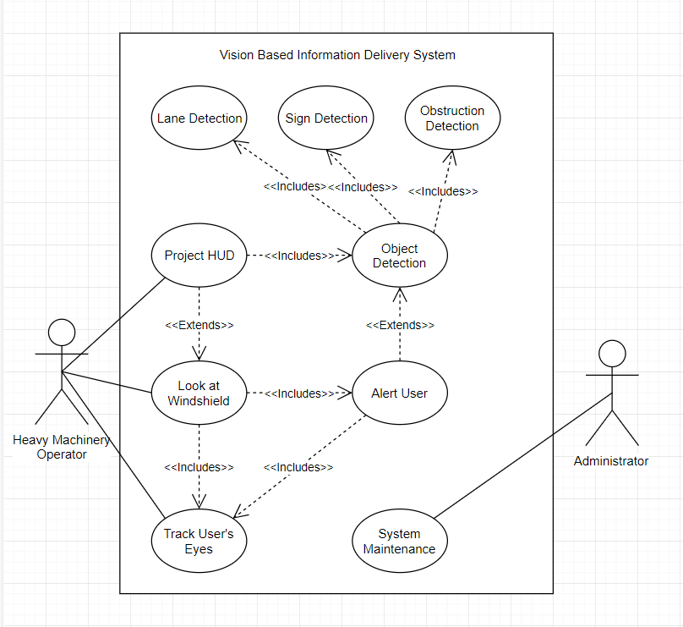
SDDEC19-14

Slide 20
Current Project Status
Jetson Flashed
Basic image detection
Basic Eye Tracker functions
SDDEC19-14

Slide 21
Task Responsibilities
Omr
Object detection
Aaron
Information display
Jonah
Eye Tracking
Object detection support
Dennis
Information display support
System integration
SDDEC19-14

Slide 22
Plan for Next Semester
Integrate the Tobii with the Jetson
Develop the display
Continue developing object detection
System to combine/use sensor data
SDDEC19-14
Notes:
Dennis can do this

